Slide 1
Robust Design &
Product Specification
Product Specification Report
Specification of Products and Services · 7 sessions · 4th semester Industrial Design
Production Manual
Product Landing Page
Specification of Products and Services · Robust Design
01

Slide 2
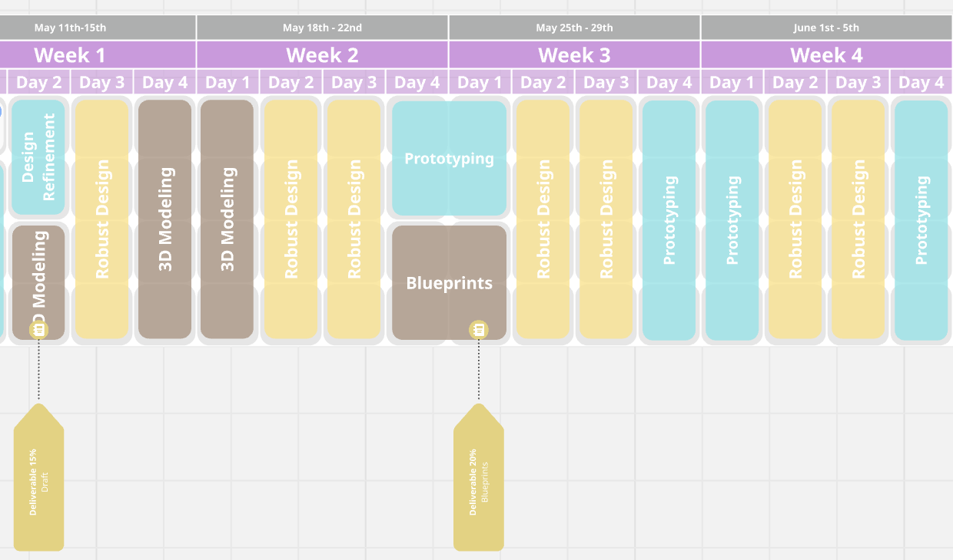
What the course is about
Students transform previous project work into technical product documentation and a public-facing product page.
1
Technical depth
Build a complete Product Specification Report / Production Manual with requirements, materials, drawings, BOM, ergonomics, production and sustainability.
2
Communication clarity
Translate the most important technical content into a concise, attractive landing page that promotes the product.
3
Progressive integration
Previous process map and schedule become inputs, not duplicated content.
Each session generates one section of the final report, so the final delivery is assembled step by step.
The course closes the loop: concept → specification → production readiness → public communication.
Specification of Products and Services · Robust Design
02

Slide 3
Final deliverables
Two connected outputs: one deep technical document and one concise promotional website.
A
Extended Product Specification Report
B
Product Landing Page
Complete technical document: concept, requirements, robust design, materials, CMF, technical/productive specs, drawings, BOM, ergonomics, MVP, sustainability, normativity and references.
A visual one-page website that promotes the product: problem, solution, key benefits, how it works, features, technical highlights, sustainability, gallery and report download link.
Report = technical evidence
Landing page = attractive communication
The website does not replace the report. It synthesizes it and makes the product easy to understand, evaluate and promote.
Specification of Products and Services · Robust Design
03

Slide 4
Course workflow
NotebookLM and AI tools help students compile, organize and convert project evidence into final outputs.
1
2
3
4
5
Collect
Organize
Draft
Publish
Present
Previous work, images, feedback, references
NotebookLM + project folder
Report sections + landing copy
Gamma / Canva / Notion / Google Sites
Critique and final delivery
Each session closes with a concrete piece of the final report and a matching website section.
Specification of Products and Services · Robust Design
04

Slide 5
Seven-session roadmap
The course is structured as a progressive build-up of the final report and landing page.
1
Diagnosis + setup
Report index + landing wireframe
2
Concept + requirements
Overview, value proposition, requirements
3
Materials + CMF
Material sheets + technical specifications
4
Production + robust design
Production flow + risk matrix
5
Drawings + BOM
Drawing package + cost/supplier table
6
Ergonomics + sustainability
Use diagrams + MVP + life cycle
7
Final integration
Report + published landing page
Specification of Products and Services · Robust Design
05

Slide 6
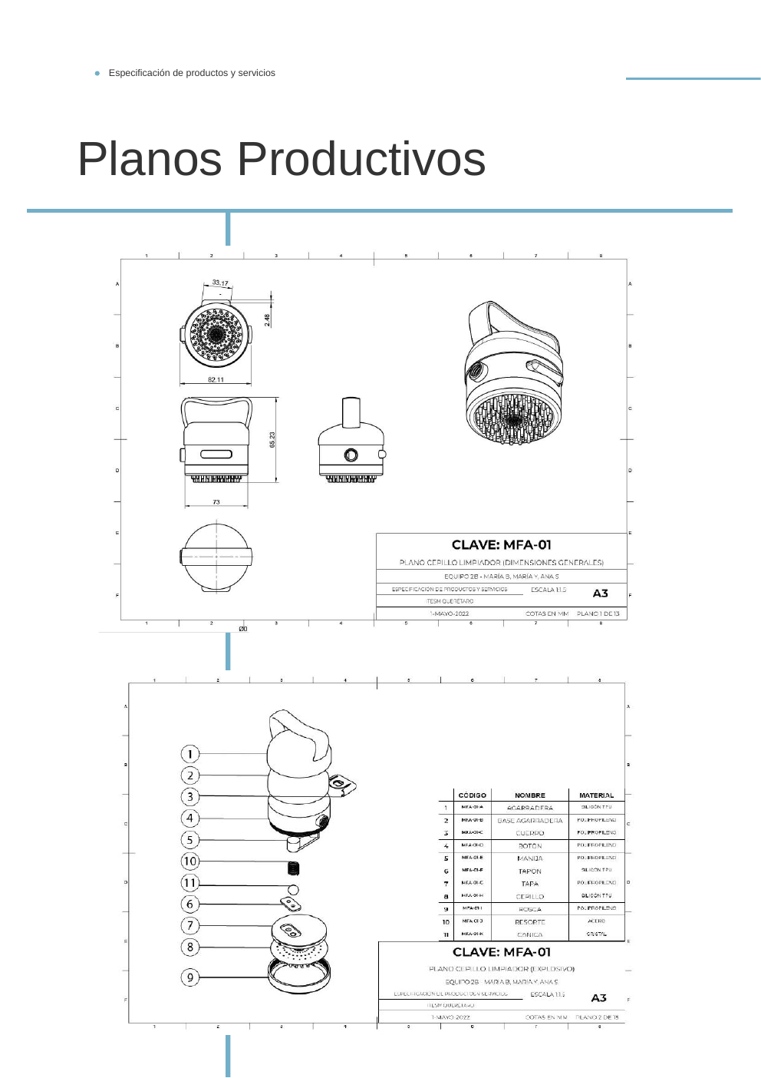
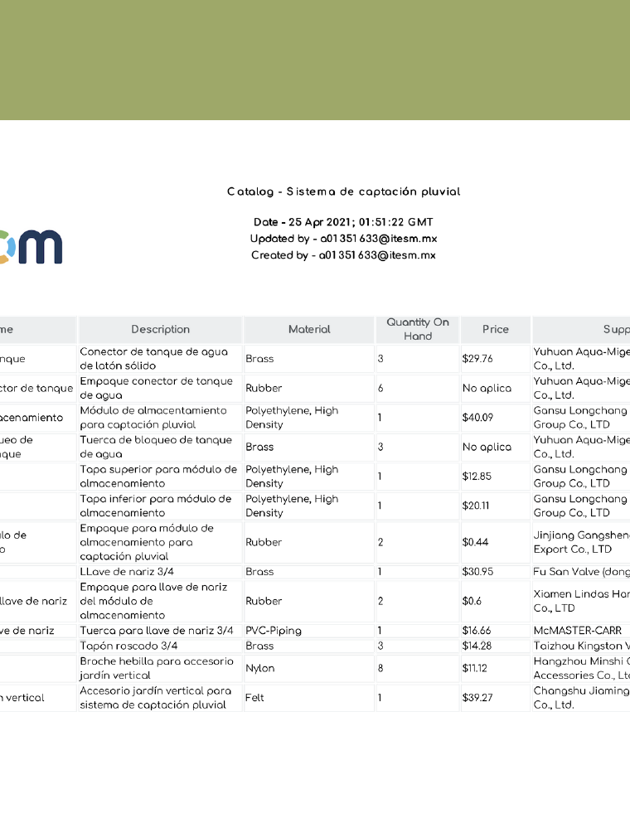
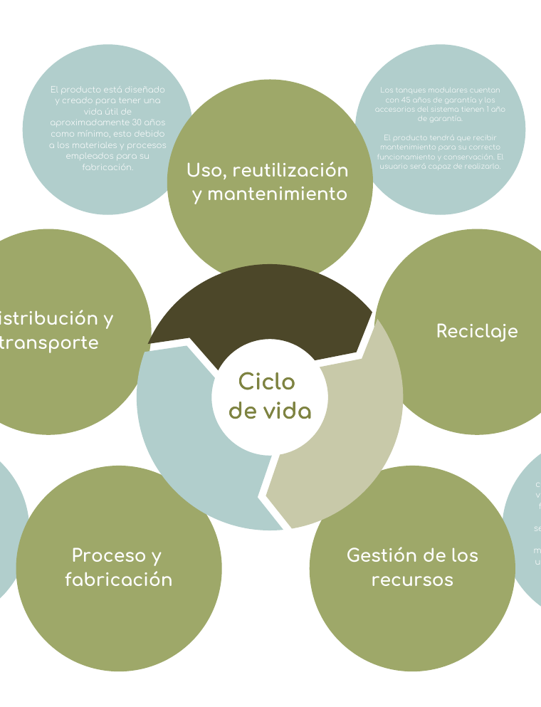
Reference quality from previous courses
Past deliverables show that the final report should be a production manual, not only a visual portfolio.
The new course adds a product landing page to communicate this technical work attractively.
Drawings
BOM + costs
Life cycle
Specification of Products and Services · Robust Design
06

Slide 7
Session 1: Project Diagnosis and Final Deliverables Setup
Start with what students already have and map what is missing for a professional final package.
Objective
Define the structure of the final report and landing page; organize existing project evidence; identify gaps and risks.
Session 1 guiding question
What evidence do we already have, and what do we still need to prove the product can be produced, used, validated and promoted?
Report output
Project overview, initial report index, technical gap analysis and robust design diagnosis.
Website output
By the end of the class, every team should know exactly what to build next.
Landing page wireframe with hero, problem, solution, benefits and key visuals to collect.
Specification of Products and Services · Robust Design
07

Slide 8
Session 1 agenda
Four hours focused on setup, diagnosis and first draft of the final structure.
00:00–00:25
Course intro
Deliverables, workflow, examples and evaluation logic
00:25–01:05
Reference review
Analyze previous manuals and extract quality criteria
01:05–01:55
Project inventory
Collect sources, images, models, feedback and existing evidence
02:10–03:05
AI-assisted diagnosis
Use NotebookLM to detect missing information and weak sections
03:05–03:45
Report + landing setup
Create report index and landing page wireframe
03:45–04:00
Exit review
Submit Session 1 evidence and next-step checklist
Specification of Products and Services · Robust Design
08

Slide 9
Activity 1: Project evidence inventory
Students organize the materials that will feed the report and landing page.
1
Concept
2
Product
brief, problem, user, sketches, moodboard
renders, 3D screenshots, prototype photos
3
Technical
4
Validation
materials, dimensions, drawings, parts, processes
feedback, tests, ergonomic notes, MVP limits
5
Business
6
Impact
market requirements, price target, suppliers, costs
sustainability, life cycle, regulations, references
victor.valencia@tec.mx
Specification of Products and Services · Robust Design
09

Slide 10
Activity 2: AI-assisted gap analysis
NotebookLM is used to compare project evidence against the expected final report.
Prompt for NotebookLM
Output 1
Missing information map
A list of gaps organized by report section.
Review all sources in this notebook and identify what information is missing to complete a professional Product Specification Report and Production Manual. Organize the missing information by: concept, requirements, materials, technical specifications, productive specifications, drawings, BOM, ergonomics, MVP, sustainability, normativity and references.
Output 2
Risk and robust design matrix
Possible failures, causes, consequences and design improvements.
Output 3
Next-step checklist
What each team must collect, draw, test or justify before Session 2.
Specification of Products and Services · Robust Design
10

Slide 11
Session 1 deliverable / evidence
What students submit at the end of the first class.
✓
Project folder
✓
NotebookLM notebook
All available project files organized and named
Sources uploaded and ready for AI-assisted review
✓
Report index
✓
Landing wireframe
Draft structure of the extended technical report
Hero, problem, solution, benefits and visual plan
✓
Gap analysis
✓
Next steps
Missing information and technical risks identified
Specific tasks assigned to team members
Next class starts from the requirements table and value proposition.
Specification of Products and Services · Robust Design
11

